Slide 1
What is Cloud Computing?
Cloud Computing is defined as storing and accessing of data and computing services over the internet.
It doesn't store any data on your personal computer. It is the on-demand availability of computer services like servers, data storage, networking, databases, etc.
The main purpose of cloud computing is to give access to data centers to many users. Users can also access data from a remote server.
Examples of Cloud Computing Services:
AWS, Azure, Google Cloud

Slide 2
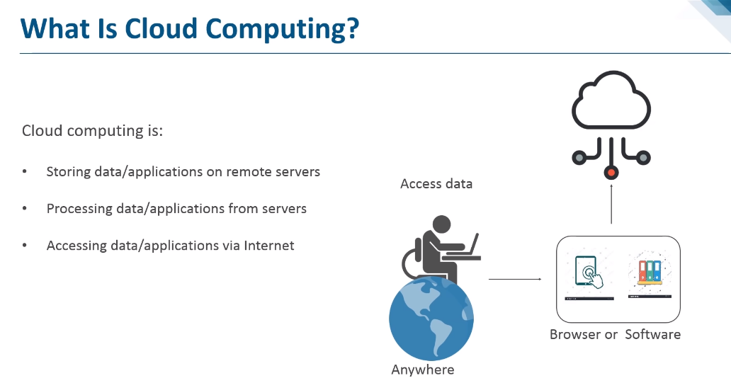

Slide 3
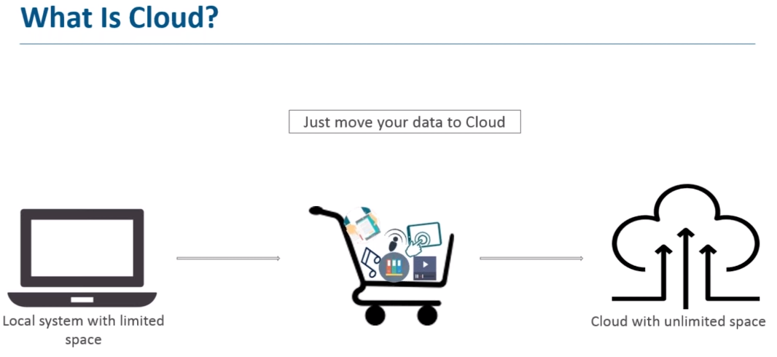

Slide 4
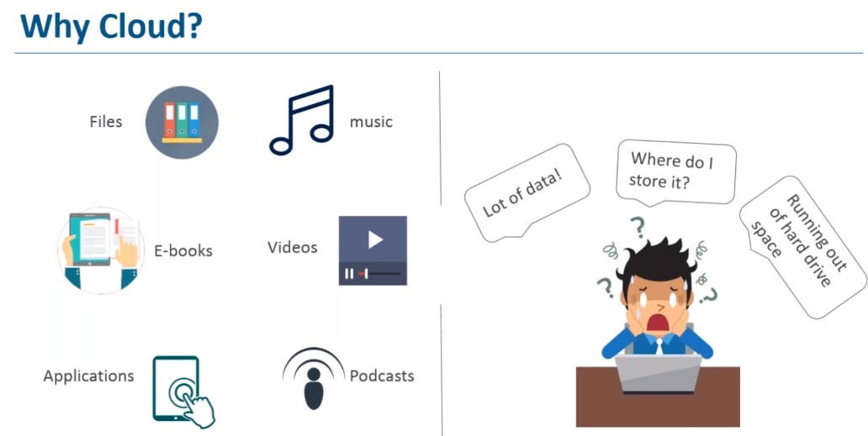

Slide 5
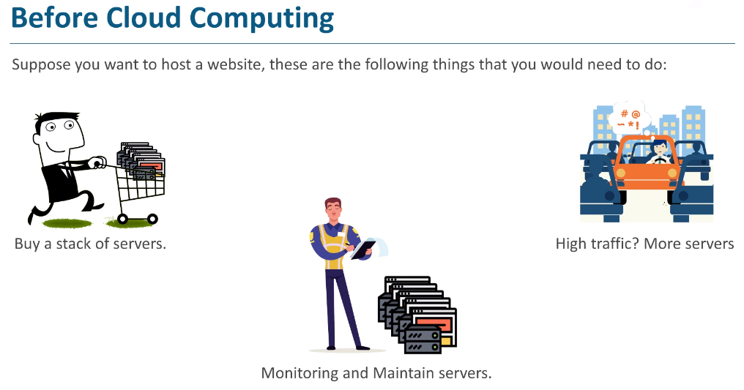

Slide 6
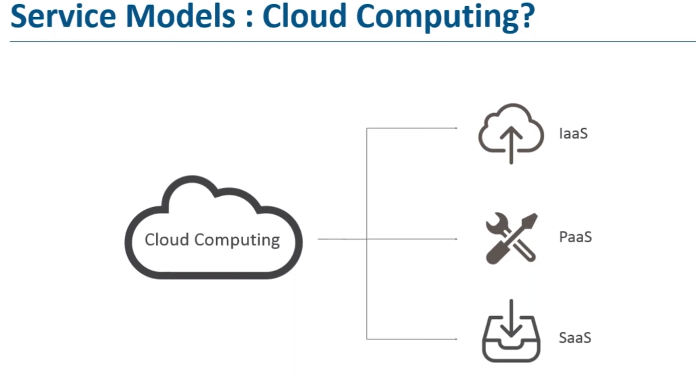
Software as a Service (SaaS)
Platform as a Service (PaaS)
Infrastructure as a Service (IaaS)

Slide 7
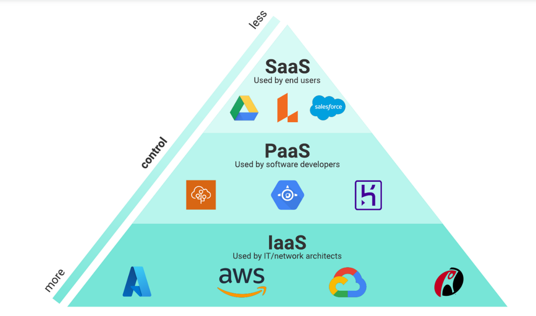

Slide 8
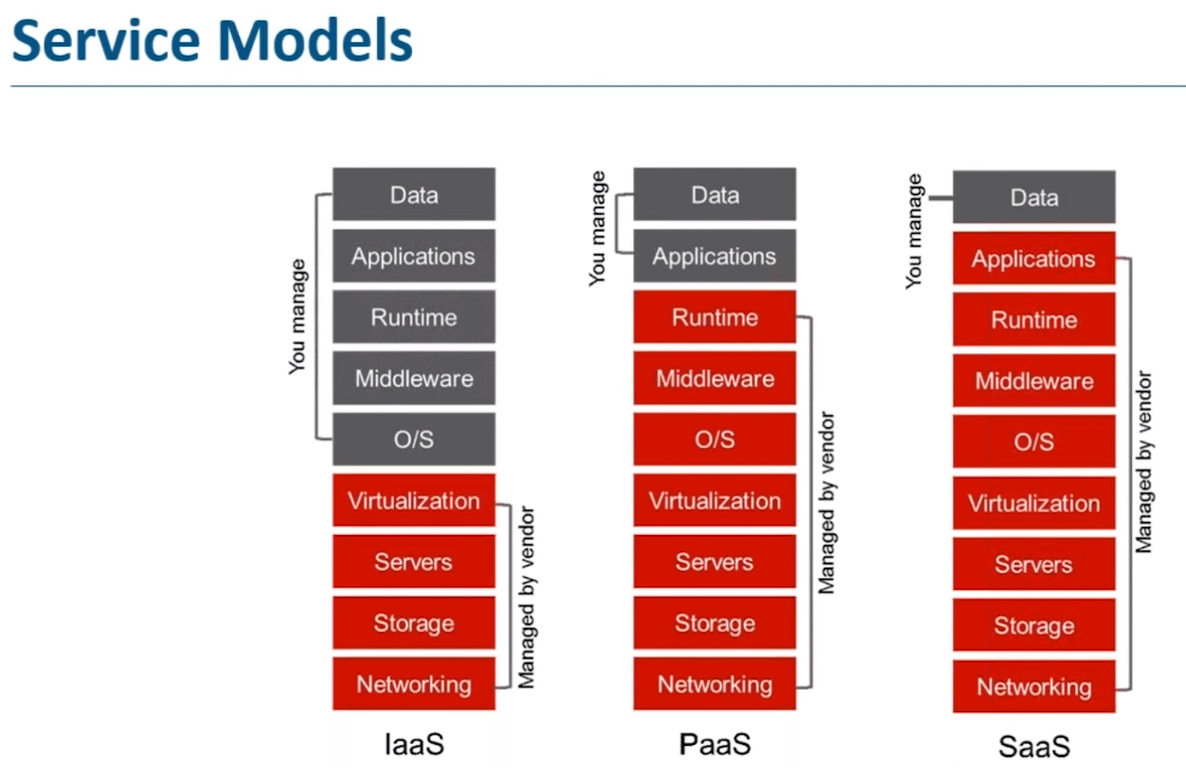

Slide 9
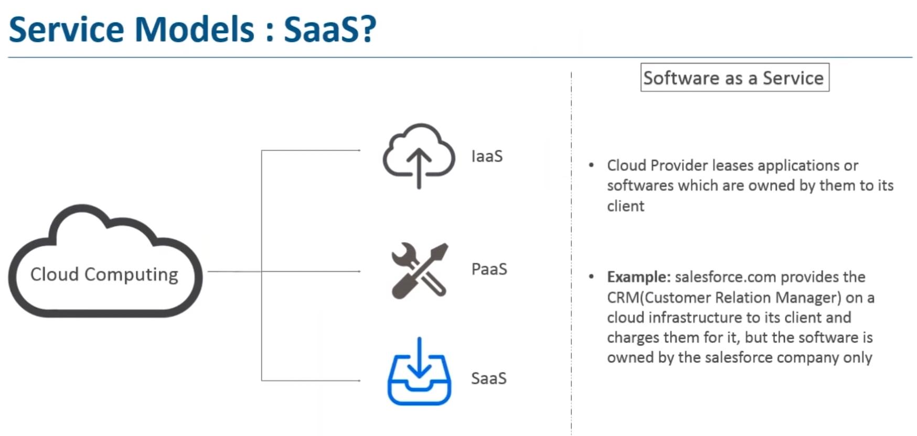

Slide 10
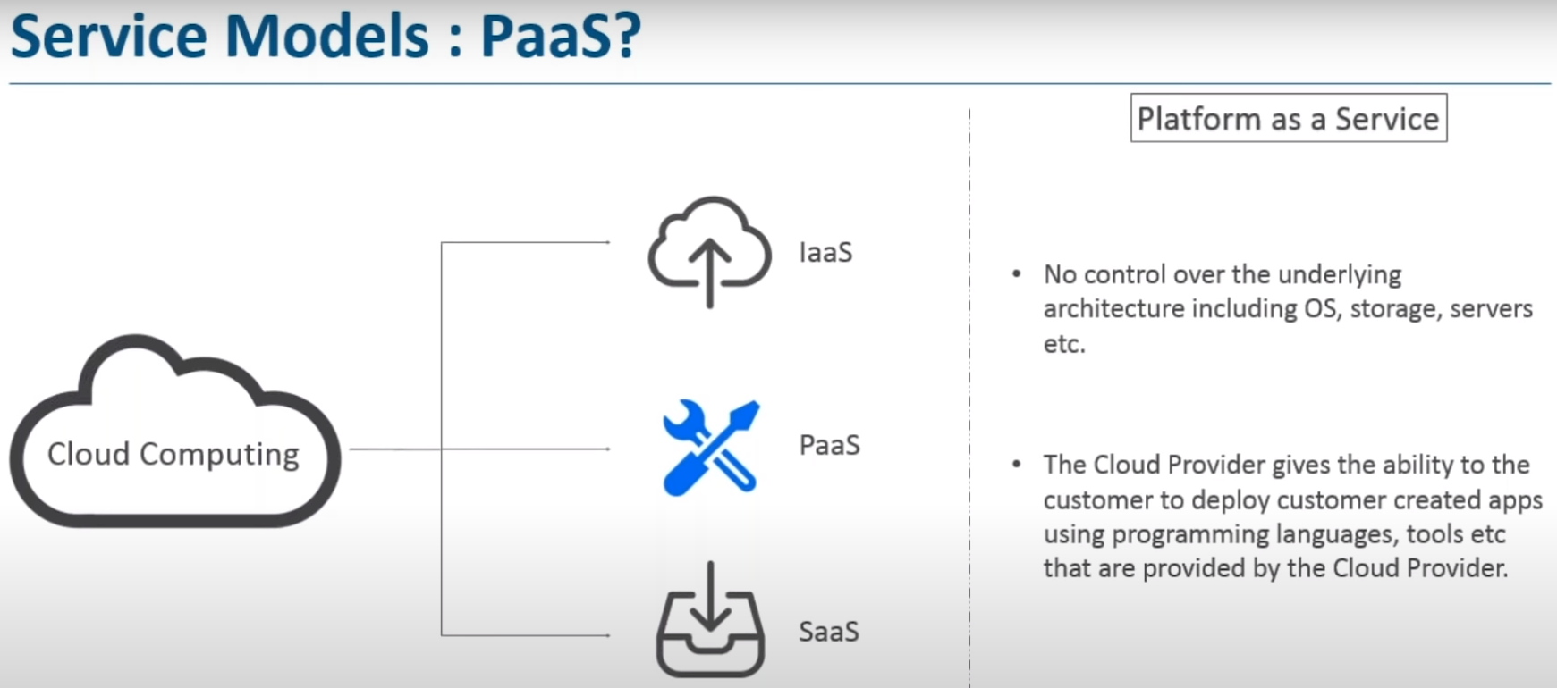

Slide 11

PaaS (Platform as a Service)
Platform as a service, is referred as PaaS, it provides a platform and environment to allow developers to build applications and services. This service is hosted in the cloud and accessed by the users via internet.
To understand in a simple terms, let compare this with painting a picture, where you are provided with paint colors, different paint brushes and paper by your schoolteacher and you just must draw a beautiful picture using those tools.

Slide 12
IaaS gives users access to storage, networking, servers, and other computing resources via the cloud. While the user is still responsible for managing their applications, data, middleware, etc.

Slide 13
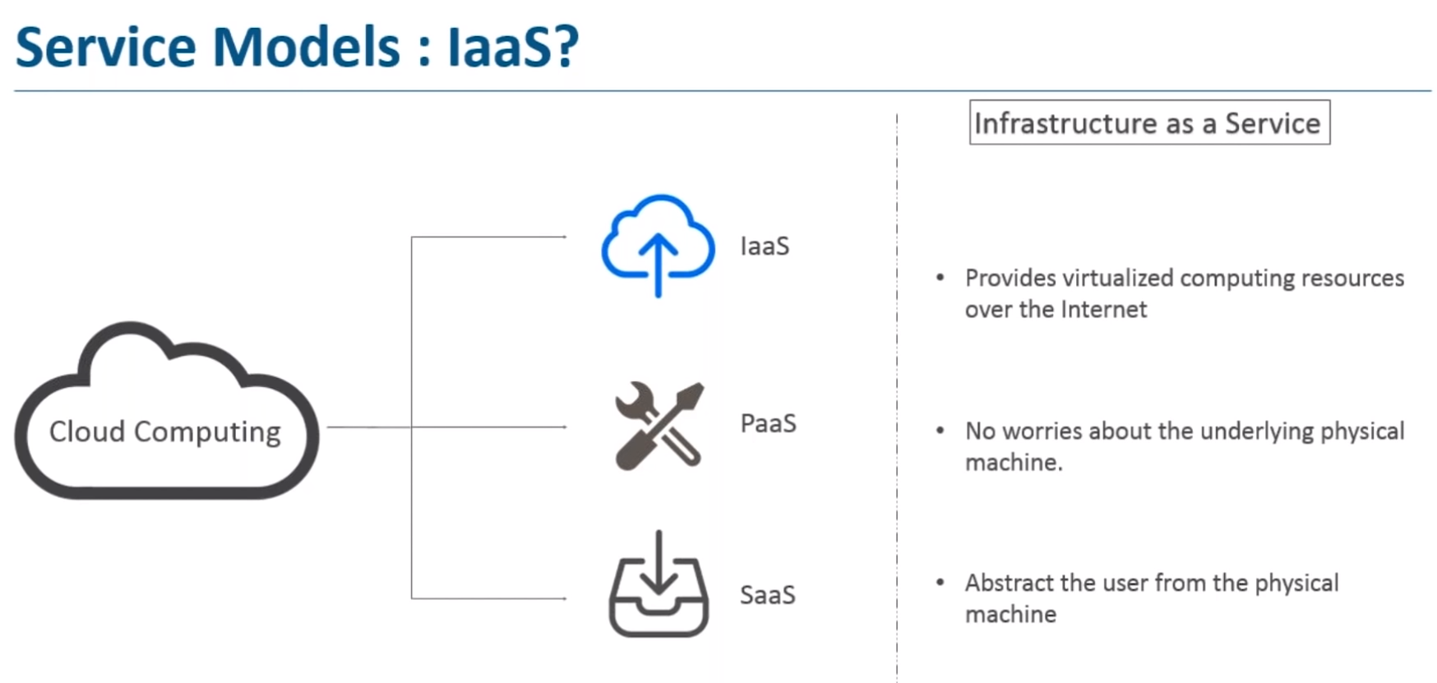

Slide 14
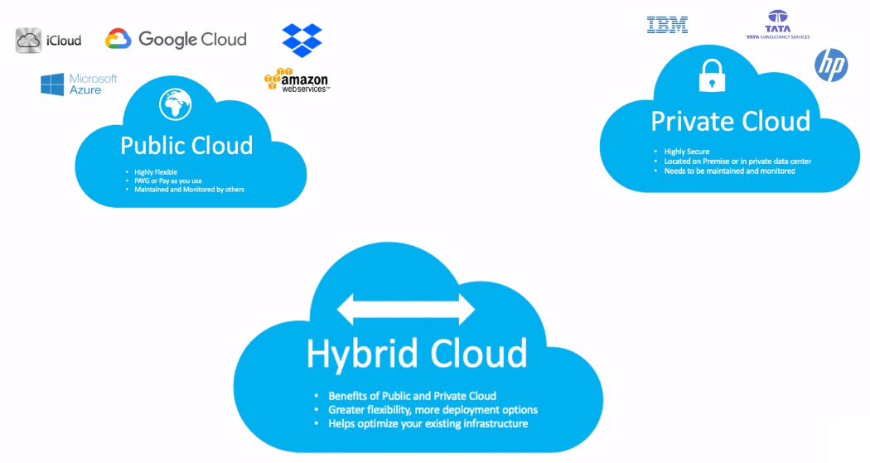

Slide 15
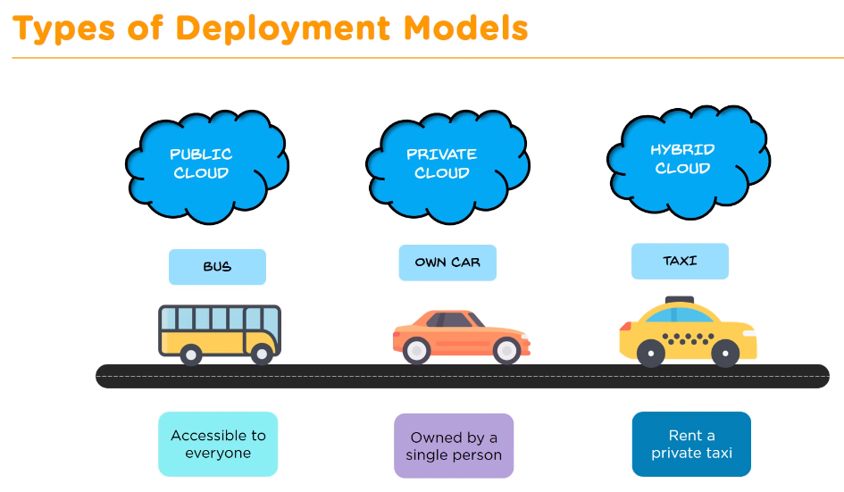

Slide 16
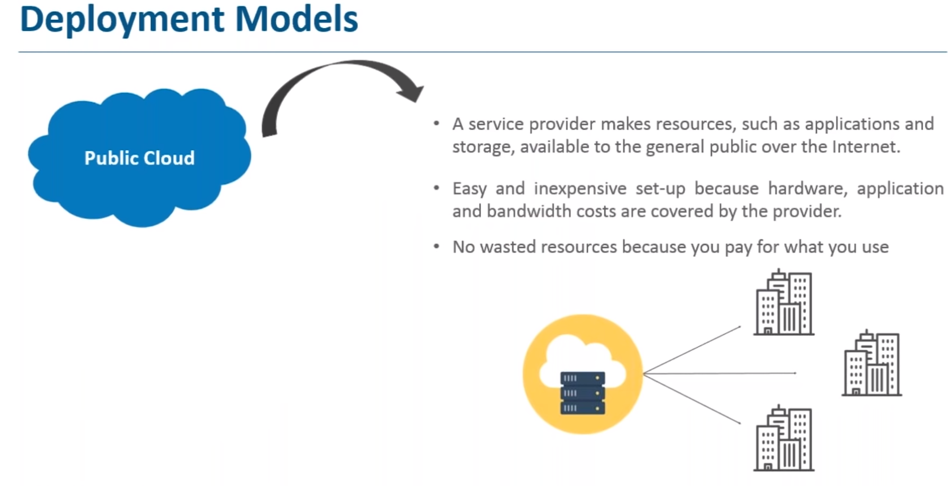

Slide 17
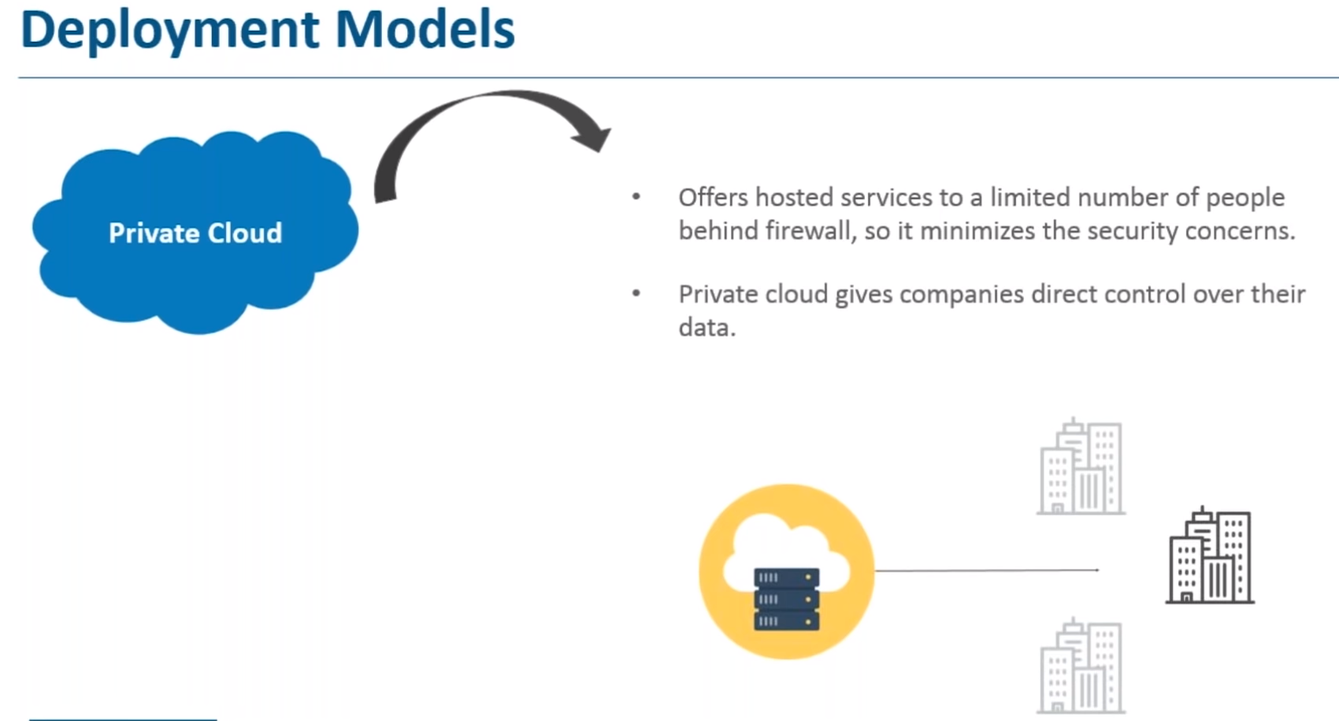

Slide 18
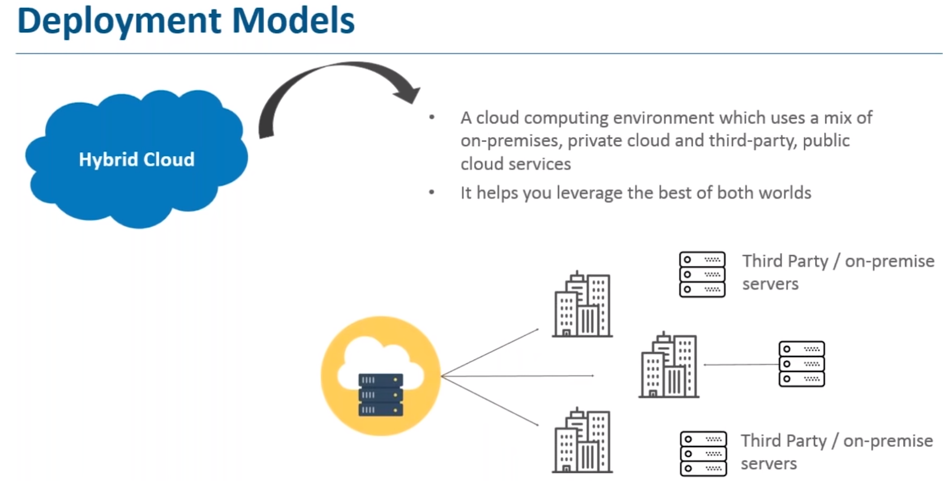

Slide 19
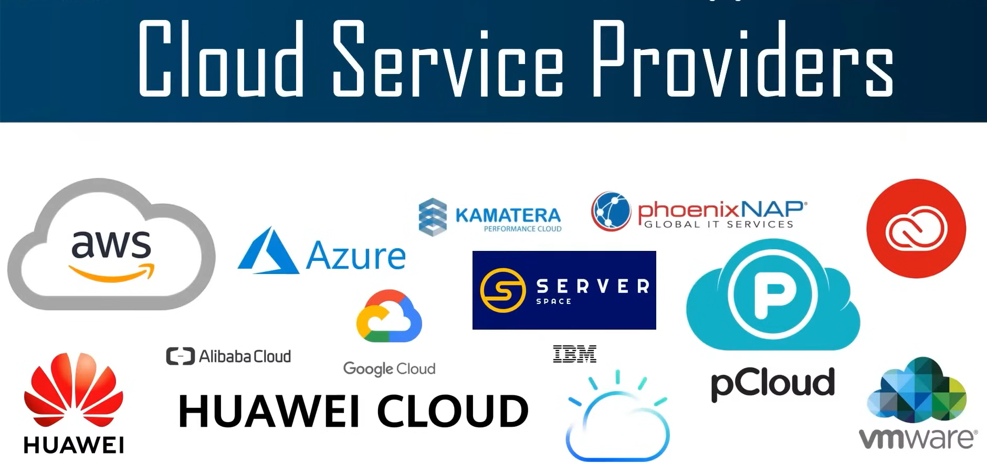

Slide 20
What is Cloud Computing Architecture?
Cloud Computing Architecture is a combination of components required for a Cloud Computing service.
A Cloud computing architecture consists of several components like a front-end platform, a back-end platform or servers, a network or internet service, and a cloud based delivery service.
Cloud computing comprises of two components front end and back end.
Front end consist client part of cloud computing system.
It comprise of interfaces and applications that are required to access the Cloud Computing or Cloud Programming platform.

Slide 21
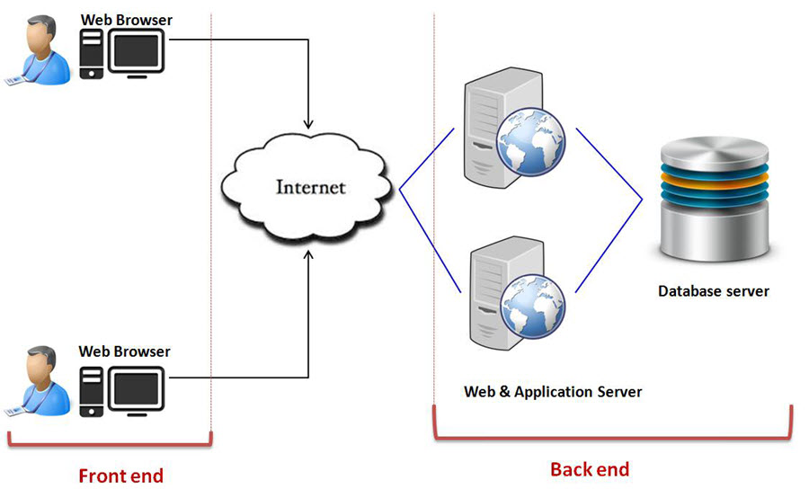

Slide 22
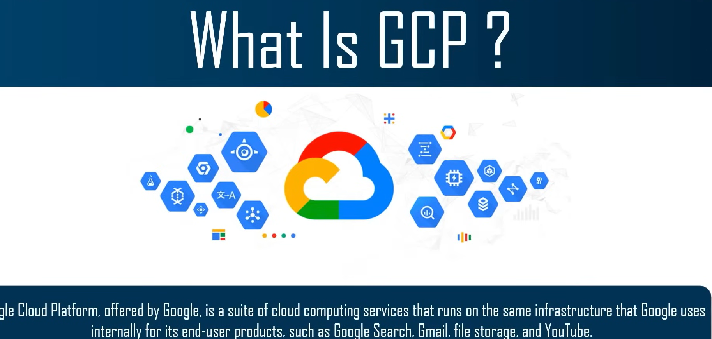

Slide 23
